Slide 1

Customer Behavior Analysis
Uncovering insights from 3,900 customer transactions to drive strategic business decisions through SQL, Python, and Power BI analysis.

Slide 2





Project Overview
Dataset Scale
Business Goal
3,900 purchases analyzed across 18 key features including demographics, purchase details, and shopping behavior.
Uncover spending patterns, customer segments, and product preferences to guide strategic decisions.
Tech Stack
SQL for queries, Python for data prep, and Power BI for visualization.

Slide 3
Data Preparation Journey
Data Cleaning
Data Loading
Imputed 37 missing review ratings using median values per product category.
Imported dataset using pandas and explored structure with df.info() and .describe().
Database Integration
Feature Engineering
Connected to SQLite3 and loaded cleaned data for SQL analysis.
Created age_group bins and purchase_frequency_days columns for deeper insights.

Slide 4
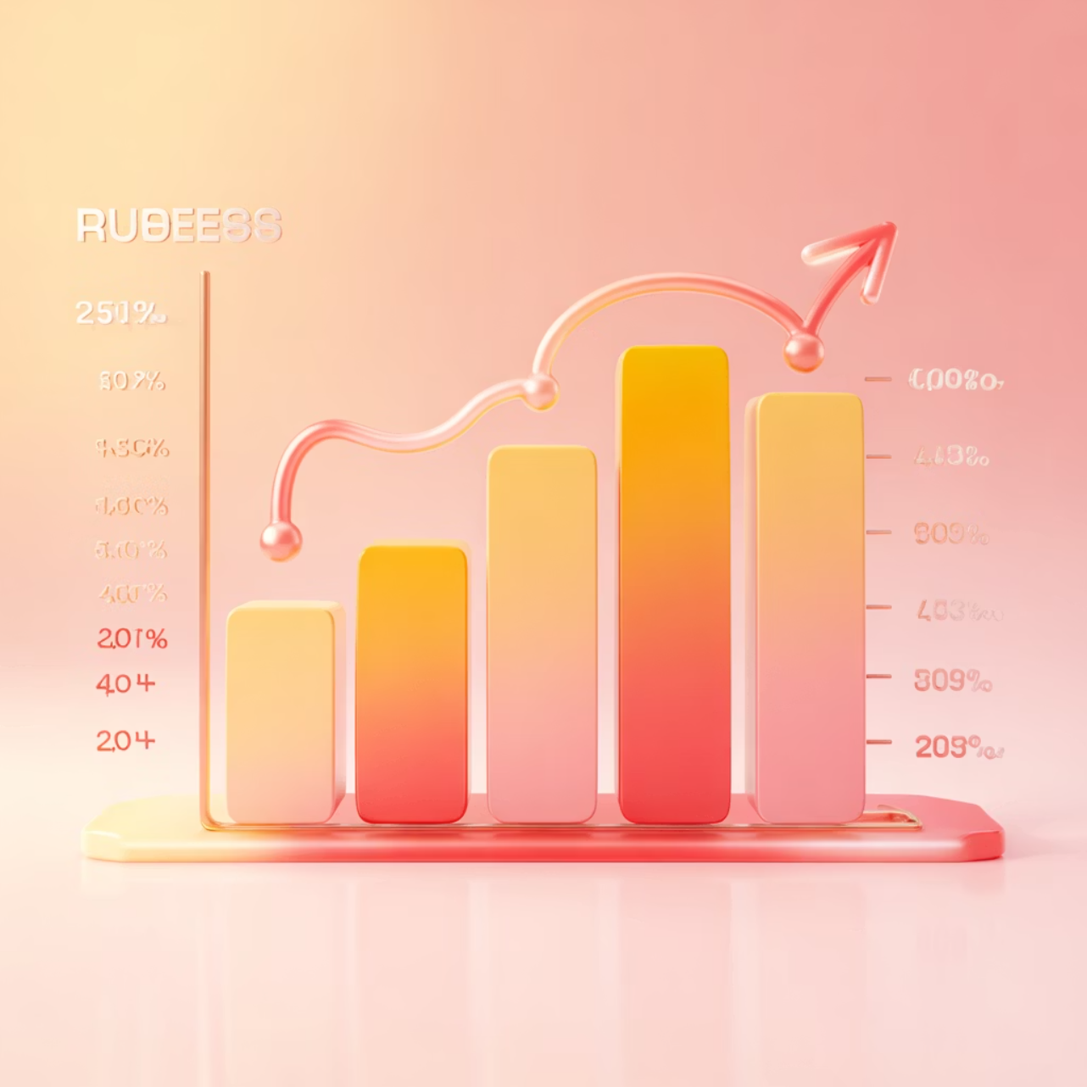
Revenue Insights by Gender
Male customers generate higher total revenue
Analysis reveals significant differences in purchasing patterns between male and female customers, with males contributing more to overall revenue.
This insight helps tailor marketing strategies and product offerings to maximize revenue from each demographic segment.

Slide 5

Smart Discount Users
High-Value Bargain Hunters
Strategic Opportunity
Identified customers who used discounts but still spent above average purchase amounts.
These customers represent ideal targets for premium product upselling despite their discount usage.

Slide 6
Top-Rated Products
Customer Favorites
Quality Indicators
Top 5 products identified by highest average review ratings drive customer satisfaction.
High ratings correlate with repeat purchases and positive word-of-mouth marketing.
Highlighting these products in marketing campaigns can boost conversion rates and build brand trust.

Slide 7

Shipping & Subscription Analysis
Express vs. Standard
Express shipping users show higher average purchase amounts, indicating willingness to pay premium for speed.
Subscriber Advantage
Subscribers generate higher average spend and total revenue compared to non-subscribers.
Repeat Buyer Correlation
Customers with >5 purchases are significantly more likely to subscribe, showing loyalty program potential.

Slide 8



Customer Segmentation
1
Loyal
2
Returning
3
New
Customers classified into three segments based on purchase history. Loyal customers represent the most valuable segment, while new customers offer growth potential through targeted engagement strategies.

Slide 9

Power BI Dashboard
Interactive visualization brings all insights together, enabling stakeholders to explore data dynamically and make informed decisions in real-time.
Real-Time Insights
Dashboard provides instant access to key metrics and trends.
Actionable Intelligence
Visual storytelling transforms raw data into strategic recommendations.

Slide 10

Strategic Recommendations
1
2
3
Boost Subscriptions
Loyalty Programs
Review Discount Policy
Promote exclusive benefits for subscribers to increase recurring revenue.
Reward repeat buyers to move them into the "Loyal" segment.
Balance sales boosts with margin control for sustainable growth.
4
5
Product Positioning
Targeted Marketing
Highlight top-rated and best-selling products in marketing campaigns.
Focus efforts on high-revenue age groups and express-shipping users.

